Slide 1
Chapter one Introduction to Data-Analytic Thinking

Slide 2
Data, Information, Knowledge, Wisdom
What is Data and Information? Are they different from Knowledge? Wisdom?
fact != data != information != knowledge
Data: Unorganized and unprocessed facts; static; a set of discrete facts about events
No meaning attached to it as a result of which it may have multiple meaning
Example: what does “Alex” mean?
Information: Aggregation of data that makes decision making easier.
Meaning is attached and contextualized
Answers questions: what, who, when, where
Notes:
Note the level becomes more abstract as we go from data, to information, and to knowledge.

Slide 3
Data, Information, Knowledge
What is Data and Information? Are they different from Knowledge?
fact != data != information != knowledge != wisdom
Knowledge: includes facts about the real world entities and the relationship between them. It is an Understanding gained through experience
Answer ‘how’ question
Notes:
Note the level becomes more abstract as we go from data, to information, and to knowledge.
It is the knowledge that we have that enables us to make decisions.

Slide 4
Data/Information Overload
Data is being produced (generated & collected) at alarming rate because of:
The computerization of business & scientific transactions
Advances in data collection tools, ranging from scanned texts & image platforms to satellite remote sensing systems
Popular use of WWW as a global information system
With the phenomenal rate of growth of data, users expect more sophisticated useful and valuable information
A marketing manager is no longer satisfied with a simple listing of marketing contacts, but wants detailed information about customers past purchasing behavior and prediction of future purchases

Slide 5
Too much data & too little knowledge
There is a need to extract knowledge (useful information) from the massive data.
The competitive pressures are strong, which needs useful information for prediction
Facing too enormous volumes of data, human analysts with no special tools can no longer make sense.
mining and management of big data can automate the process of finding patterns & relationships in raw data and the results can be utilized for decision support. That is why data mining is used, especially in science and business areas.
If we know how to reveal valuable knowledge hidden in raw data, data might be one of our most valuable assets.
Data mining is the tool that involves retrospective analysis to extract diamonds of knowledge from historical data & predict outcome of the future.

Slide 6
Discussion
Review different literatures (books and articles) & write a report (overview, significance, steps involved, applications) and present in class within 10 minutes.
Data Warehouses and OLAP technology in data mining ()
Predictive Modeling
Descriptive Modeling
Data Mining Models (like CRISP, Hybrid, & other models)
Text Mining
Web Mining
Sentiment/opinion mining
Knowledge Mining
Multimedia Data Mining

Slide 7
What is data mining?
Data Mining is a technology that uses various techniques to discover hidden knowledge from heterogeneous and distributed historical data stored in large databases, warehouses and other massive information repositories so to find patterns in data that are:
valid: not only represent current state, but also hold on new data with some certainty
novel: sound and relevant
useful: should be possible to act on the item or problem (useful to solve business problem)
understandable: humans should be able to interpret the pattern

Slide 8
Why DM Now?
Four main reasons why DM now?
The competitive pressure is very strong
How to gain competitive advantage?
How to control the volatile market?
How to satisfy customers need?
How to manage the high turnover rate of professionals?

Slide 9
Why DM Now: Massive data collection
Massive data collection: large databases (data warehouses) are growing at unprecedented rates to manage the explosive growth in stored data.
Examples of massive data sets
The current NASA Earth observation satellites generate a terabyte (i.e. 10⁹ bytes) of data every day.
Google: Order of 10 billion Web pages indexed
100’s of millions of site visitors per day
MEDLINE text database: 17 million published articles
Retail transaction data: EBay, Amazon, Wal-Mart: order of 100 million transactions per day
Visa, MasterCard: similar or larger numbers

Slide 10
Why DM Now: Powerful computers
Powerful computers: The computing power is increased and is also affordable
The need for improved computational engines can now be met in a cost-effective manner with parallel multiprocessor computer technology.
Technological Driving Factors
Larger, cheaper memory (in hundred GBs, not in MBs)
Moore’s law for magnetic disk density “capacity doubles every 18 months”
Storage cost per byte falling rapidly
Faster, cheaper processors (in GHz, not in MHz)
the CRAY of 15 years ago is now on your desk
Success of Relational Databases and the World Wide Web
everybody is a “data owner”

Slide 11
Why DM Now: DM algorithms
Commercial products (for data mining) are available
Data mining algorithms have been matured & there are reliable tools that consistently outperform older statistical methods.
New ideas in machine learning/statistics
Boosting, SVMs, decision trees, Bayes, text models, etc
Existence of around 20-30 mining tool vendors

Slide 12
Example: Why Data Mining
Fraud detection/Network intrusion detection
Which types of transactions are likely to be fraudulent, given the demographics and transactional history of a particular customer?
Customer relationship management:
Which of my customers are likely to be the most loyal, and which are most likely to leave for a competitor?
Credit ratings:
Given a database of 100,000 names, which persons are the least likely to default on their credit cards?
Targeted marketing:
Identify likely responders to sales promotions
Data Mining helps extract such useful information

Slide 13
Database Processing vs. Data Mining Processing
 | Database | Data mining | Comments
Query | Well defined Structured Query Language | Poorly defined No precise query language | The data miner might not know what he exactly wants to see
Data | Operational data | Non-Operational data | The data have been cleansed and modified to better support the mining process
Output | Precise and Subset of database | Not a subset of database | The output is some hidden useful patterns & knowledge in the database

Slide 14
Query Examples
Database
Find all credit applicants with first name ‘Alex’.
Identify customers who have purchased more than Birr 10,000 in the last month.
Find all customers who have purchased Bread
Data Mining
Find all credit applicants who have no credit risks. (classification)
Identify customers with similar buying habits. (Clustering)
Find all items which are frequently purchased with Bread. (association rules)

Slide 15
Data Mining works with Data Warehouse
Data Warehouse provides the Enterprise with a memory
Data Mining provides the Enterprise with intelligence

Slide 16
Data Warehouse
Data warehouse
A data warehouse is a collection of different relational database management system responsible for the collection and storage of data to support management decision making and problem solving.
It enables managers and other business professionals to undertake Big data mining, online analytical processing, market research and decision support.
Current evolution of Decision Support Systems (DSSs)
Data mart
A subset of a data warehouse for small and medium-size businesses or departments within larger companies

Slide 17
Data warehousing
Data warehouse is an integrated, subject-oriented, time-variant, non-volatile database that provides support for decision making.
Integrated → centralized, consolidated database that integrates data derived from the entire organization.
Consolidates data from multiple & diverse sources with diverse formats.
Helps managers to better understand the company’s operations.
Subject-Oriented → Data warehouse contains data organized by topics.
E.g. Sales, marketing, finance, etc.

Slide 18
Data warehousing
Time variant → In contrast to the operational database that focus on current transactions, the data warehouse represent the flow of data through time.
Data warehouse contains data that reflect what happened last week, last month, past five years, and so on.
Non volatile → Once data enter the data warehouse, they are never removed. Because the data in the warehouse represent the company’s entire history.
Because data is added all the time, warehouse is growing.

Slide 19
Database & data warehouse: Differences
The data warehouse and operational environments are separated. Data warehouse receives its data from operational databases.
Data warehouse environment is characterized by read-only transactions to very large data sets.
Operational environment is characterized by numerous update transactions to a few data entities at a time.
Data warehouse contains historical data over a long time horizon.
Ultimately Information is created from data warehouses. Such Information becomes the basis for rational decision making.
The data found in data warehouse is analyzed to discover previously unknown data characteristics, relationships, dependencies, or trends.

Slide 20
Business Intelligence
BI takes advantage of data mining and data warehousing to help organizations gather their information in a timelier and in a more valuable manner
BI keeps the organization:
informed about the market trends,
alerts to new market potentials,
helps to determine how competitors are doing
Business intelligence is information about a company's past performance that is used to help predict the company's future performance.
It can reveal emerging trends from which the company might profit.
Without such information and knowledge the organization may suffer false growth or setbacks

Slide 21
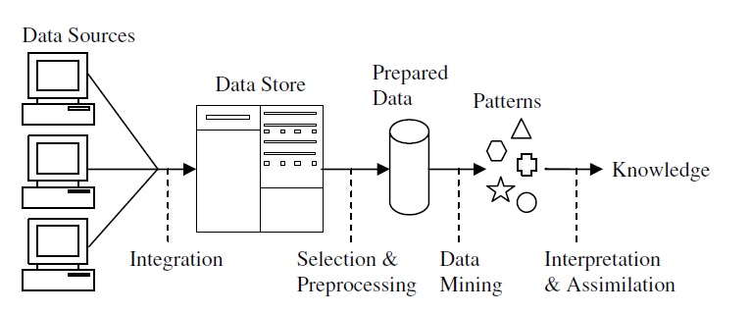
Data Warehouse as part of Data Mining

Slide 22
Knowledge Discovery in Databases(KDD)
KDD is often used as a synonym for Data Mining.
Some author define KDD as the whole process involving: data selection ➔ data pre-processing: cleaning ➔ data transformation ➔ mining ➔ result evaluation ➔ visualization
Data Mining, on the other hand, refer to the modeling step using the various techniques to extract useful information/pattern from the data.
KDD is the process of finding useful information and patterns in data
DM is the use of algorithms to extract hidden patterns & knowledge in data

Slide 23
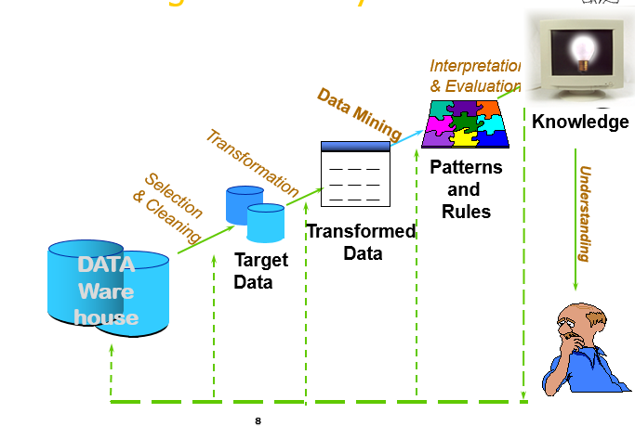
The KDD process

Slide 24
Stages in DM: The KDD process
Data integration: at this stage, multiple data sources, often heterogeneous, may be combined in a common source.
Data selection: at this step, the data relevant to the analysis is decided on and retrieved from the data collection.
Preprocessing: Cleanse inconsistent & incorrect data; fills incomplete records; predict missing values; correct erroneous & anomalous data.
Transformation: Convert data from different sources into common new format. Apply data reduction & data categorization/binning to ease data mining
Mining: apply classification or clustering techniques to obtain predictive or descriptive models.
Interpretation/Evaluation: Present results to user in meaningful manner using various visualization and GUI strategies.

Slide 25
DM Process Ex: Web Log
Selection:
Select log data (dates and locations) to use
Preprocessing:
Remove error logs
Transformation:
sort and group
Data Mining:
Identify and count patterns
Construct data structure
Interpretation/Evaluation:
Identify and display frequently accessed sequences.

Slide 26
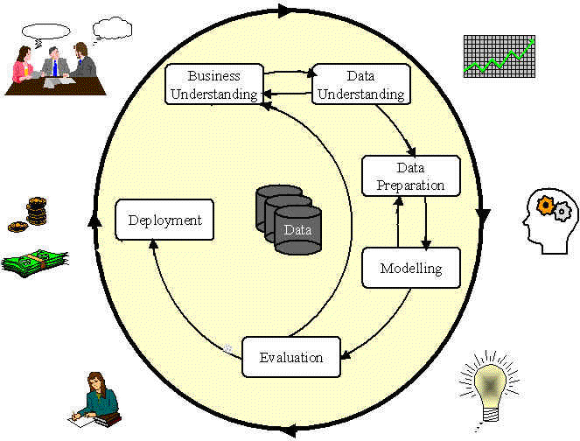
CRoss Industry Standard Process for Data Mining (CRISP-DM)

Slide 27
Phases and Tasks
Business Understanding | Data Understanding | Data Preparation | Modeling | Evaluation | Deployment
Determine Business Objectives Background Business Objectives Business Success Criteria | Collect Initial Data Initial Data Collection Report | Data Set Description Select Data Rationale for Inclusion / Exclusion | Select Modeling Technique Modeling Assumptions | Evaluate DM Results Assess Results w.r.t. Business Success criteria Approved Models | Plan Deployment Deployment Plan
Assess Situation Inventory of Resources Requirements, Assumptions, & Constraints, Risks & Contingencies Terminology ; Costs and Benefits | Describe Data Data Description Report | Clean Data Data Cleaning Report Construct Data: Derived Attributes Generated Records | Generate Test Design Test Design | Review Process Review of Process | Plan Monitoring & Maintenance Monitoring and Maintenance Plan
Determine Data Mining Goal Data Mining Success Criteria | Explore Data Data Exploration Report | Integrate Data Merged Data | Build Model Parameter Settings; Model construction | Determine Next Steps List of Possible Actions Decision | Produce Final Report Final Presentation
Produce Project Plan Initial Asessment of Tools and Techniques | Verify Data Quality Data Quality Report | Format Data Reformatted Data | Assess Model Model Assessment Revised Parameter Settings |  | Review Project Experience Documentation

Slide 28
Hybrid Knowledge Discovery Process

Slide 29
Origins of Data Mining
pre 1960 1960’s 1970’s 1980’s 1990’s
Hardware
(sensors, storage, computation)
Relational
Databases
Data
Mining
AI
Pattern
Recognition
Machine
Learning
“Flexible Models”
EDA
“Pencil
and Paper”
“Data Dredging”

Slide 30
DM: Intersection of Many Fields
Data mining overlaps with machine learning, statistics, artificial intelligence, databases, visualization
Machine Learning (ML)
Data structure & algorithm analysis
Statistics (stats)
Visualization (viz)
Data
Mining
Databases (DB)
Human Computer
Interaction (HCI)
High-Performance
Parallel Computing
Information retrieval

Slide 31
Data Mining Metrics
How to measure the effectiveness or usefulness of data mining approach?
Return on Investment (ROI)
From an overall business or usefulness perspective a measure such as ROI is used
ROI compares costs of DM techniques against savings or benefits from its use
Accuracy in classification
Analyze true positive and false positive to calculate recall, precision of the system
Measure percentage of correct classification
Space/Time complexity
Running time: how fast the algorithm runs
Storage or memory space requirement

Slide 32
Data Mining implementation issues
Scalability
Applicability of data mining techniques to perform well with massive real world data sets
Techniques should also work regardless of the amount of available main memory
Real World Data
Real world data are noisy and have many missing attribute values. Algorithms should be able to work even in the presence of these problems
Updates
Database can not be assumed to be static. The data is frequently changing.
However, many data mining algorithms work with static data sets. This requires that the algorithm be completely rerun any time the database changes.

Slide 33
Data Mining implementation issues
High dimensionality:
A conventional database schema may be composed of many different attributes. The problem here is that all attributes may not be needed to solve a given DM problem.
The use of unnecessary attributes may increase the overall complexity and decrease the efficiency of an algorithms.
The solution is dimensionality reduction (reduce the number of attributes). But, determining which attributes are not needed is a tough task!
Overfitting
The size and representativeness of the dataset determines whether the model associated with a given database states fits to also future database states.
Overfitting occurs when the model does not fit to the future states which is caused by the use of small size and unbalanced training database.

Slide 34
Data Mining implementation issues
Ease of Use of the DM tool
Since data mining problems are often not precisely stated, interfaces may be needed with both domain and technical experts
Although some techniques may work well, they may not be accepted by users if they are difficult to use or understand
Application
Determining the intended use for the information obtained from the DM tool is a challenge.
Indeed, how business executives can effectively use the output is sometimes considered the most difficult part. Because the results are of a type that have not previously been known.
Business practices may have to be modified to determine how to effectively use the information uncovered

